Slide 1
Visual Geometry Grounded Deep Structure From Motion
Collaborative Project: Visual Geometry Group (Oxford) × Meta AI Research
Group Members:
Hassan Sheraz
Ravali Maddela
Vishal Reddy

Slide 2
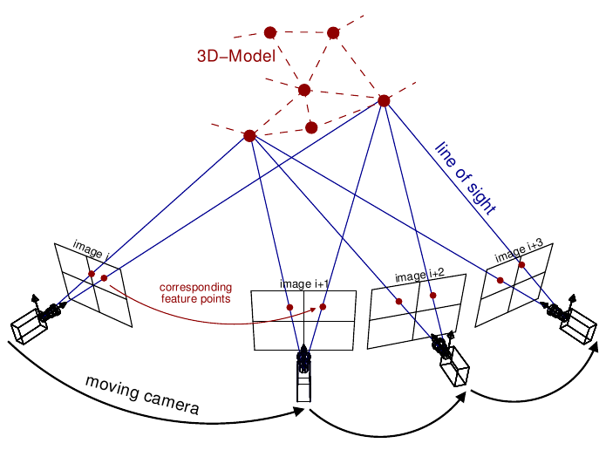
What is Structure from Motion?
Structure-from-Motion (SfM) is a technique in computer vision that reconstructs the 3D structure of a scene and the motion (position and orientation) of the camera from a series of 2D images.It is foundational in:
Robotics (for navigation and mapping)
Augmented Reality (AR)
Photogrammetry (3D scanning from drones)
Cultural heritage preservation (reconstructing historical sites)

Slide 3
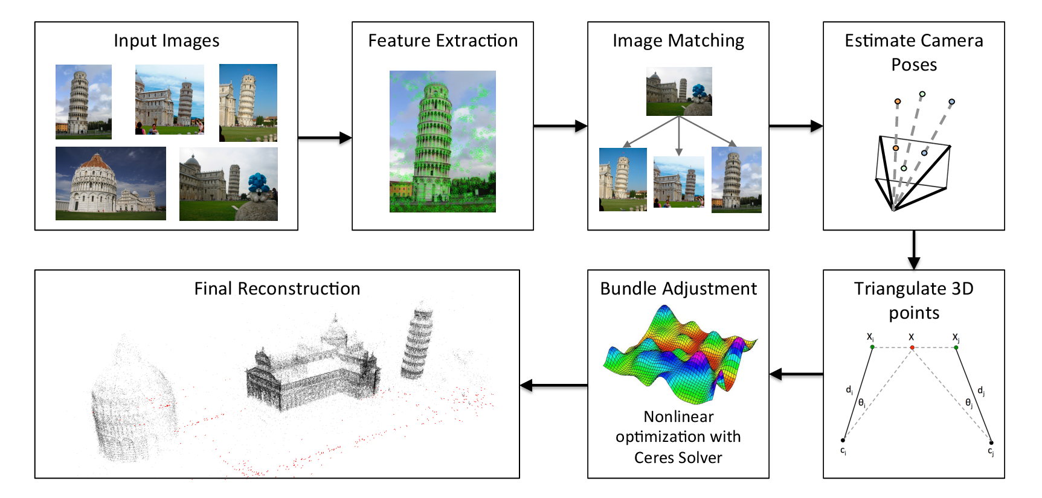
Classical SFM Pipeline
Follows an incremental modular pipeline:
Detect keypoints (e.g., SIFT, ORB)
Match keypoints across images
Estimate camera poses (PnP + RANSAC)
Triangulate 3D points
Refine with Bundle Adjustment (BA)
Each step is hand-engineered and separate
Limitations:
No learning from data + Pipeline is not differentiable or end-to-end trainable

Slide 4
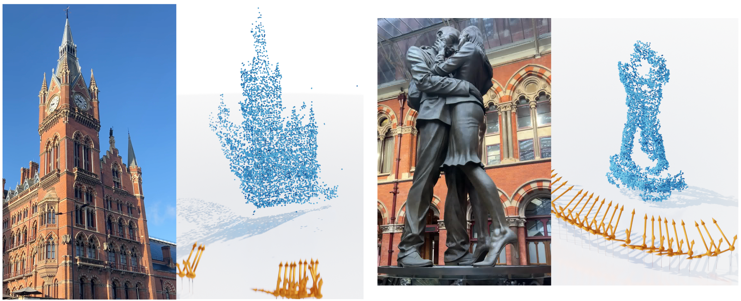
What VGGSfM Does Differently
VGGSfM (the method proposed in this paper) changes the game. It’s a deep learning based SfM system where every part of the pipeline is trainable — a big improvement over classical methods.
Here's what it does:
Pixel-accurate tracking Instead of comparing just image pairs
All camera poses estimated at once Instead of registering cameras one-by-one,
Differentiable optimization
https://huggingface.co/spaces/facebook/vggsfm

Slide 5
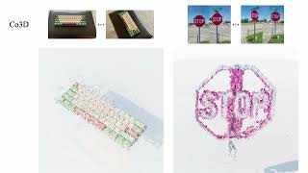

Slide 6
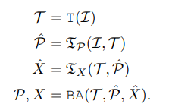
Method Overview
Method Input and Objective: 1. Input: Set of RGB images I = {I₁, ..., I_N} of a static scene 2. Goal: Estimate camera projection matrices P = {P₁, ..., P_N}
VGGSfM implements SfM via a single function fθ(I) = (P, X)
Pipeline structure: 1. T = Tracker(I) → Outputs 2D tracks 2. P̂ = TP(I, T) → Estimates initial camera poses 3. X̂ = TX(T, P̂) → Estimates initial 3D structure 4. (P, X) = BA(T, P̂, X̂) → Final refinement using differentiable bundle adjustment

Slide 7
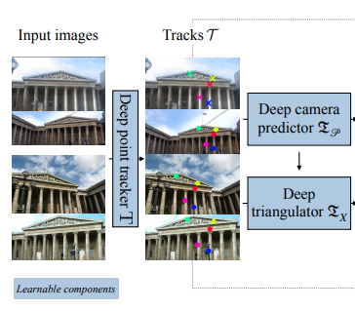
Tracker – The Foundation of VGGSfM
Problem: Traditional SfM relies on brittle keypoint chaining
Solution: Deep Transformer-based tracker
Benefits:
Direct tracking across all images simultaneously
No need for temporal ordering of frames
Eliminates error accumulation from pairwise matching

Slide 8
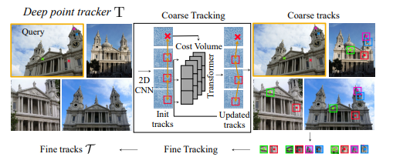
Tracker Architecture
Figure:
Input: Collection of images + query points
Process: CNN extracts features → Cost volume pyramid → Transformer
Output: 2D tracks with visibility indicators
Key innovation: Tracks points across ALL images at once (not pairwise)

Slide 9
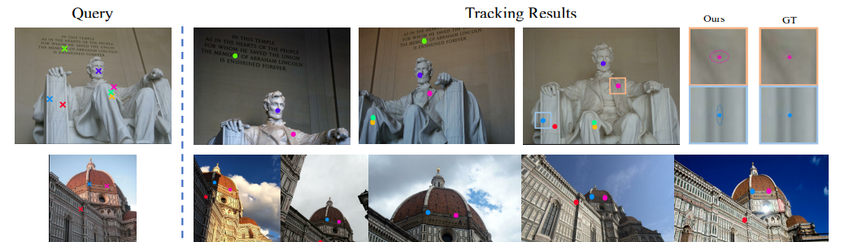
Confidence-Aware Tracking
Uncertainty modeling:
Predicts variance σ for each track point
Creates probabilistic track point estimates
Higher confidence = lower variance
Applications:
Filtering unreliable correspondences
Weighting in the loss function
Visualization as confidence ellipses (as shown in Figure)

Slide 10
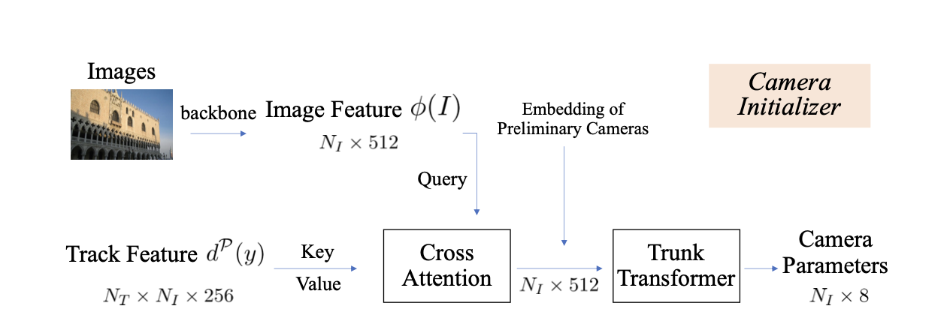
Camera Initialization
Input: Image features + track descriptors
Architecture:
ResNet50 backbone extracts global image features
Cross-attention between image features and track descriptors
Transformer processes attended features
Optional: Initial camera estimate from 8-point algorithm
Output: Camera parameters for all images (simultaneously!)

Slide 11
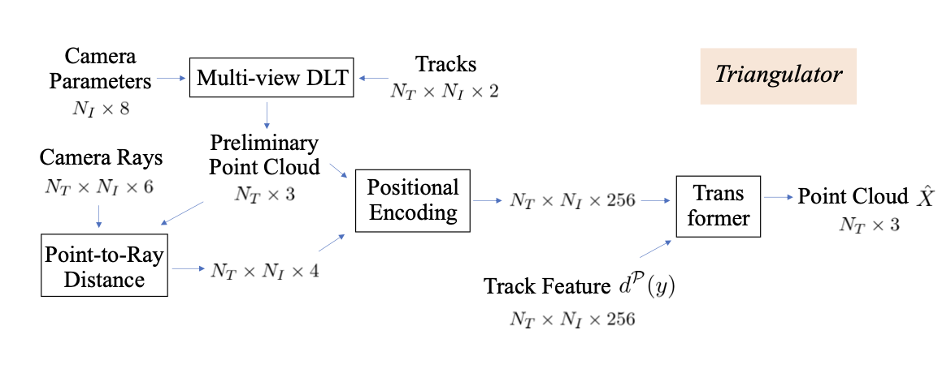
Learnable Triangulation
Input: Track features + camera parameters
Process:
Initial 3D point cloud from Direct Linear Transform (DLT)
Features enhanced with ray-point distances
Transformer refines 3D point locations
Key advantage: Learns to handle noise and ambiguity

Slide 12




Differentiable Bundle Adjustment
Purpose: Joint optimization of cameras + 3D points
Innovation: Fully differentiable LM optimizer using Theseus
Equation 6: Minimizes reprojection errors
Key benefit: Allows backpropagation through the optimization

Slide 13
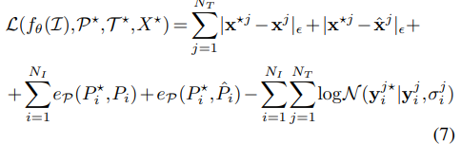
Training the Complete Pipeline
Loss Function Components
3D Point Accuracy: |xj - xj|ε + |xj - x̂j|ε
Camera Pose Error: eP(Pi, Pi) + eP(Pi, P̂i)
Track Point Confidence: log N(y*ji | yji, σji)
Training Strategy
Component-wise Training
Separate training of tracker
Gradually add camera initializer and triangulator
End-to-End Joint Fine-Tuning
Combine all components
Enable mutual learning
Improve overall reconstruction performance

Slide 14
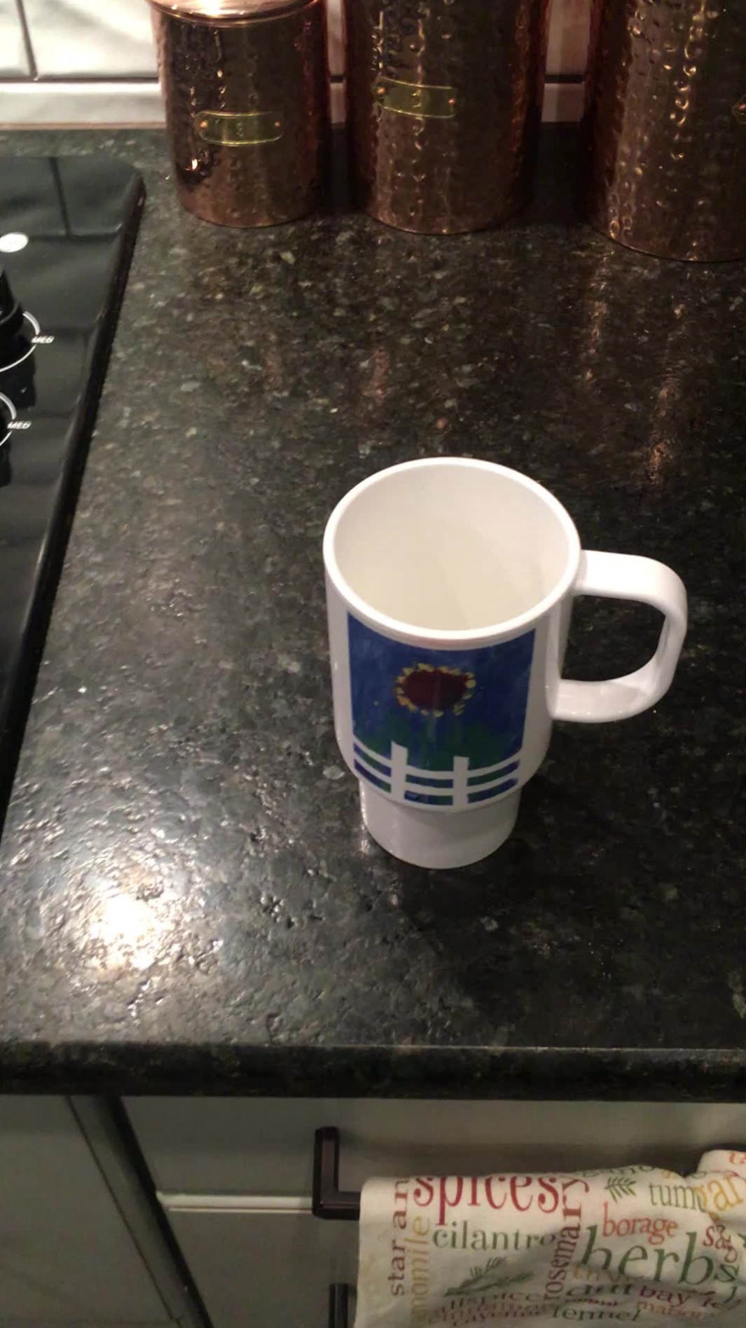
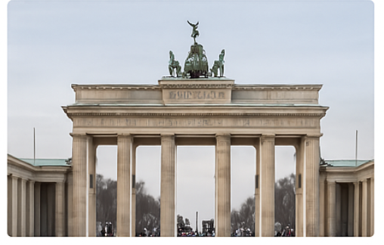
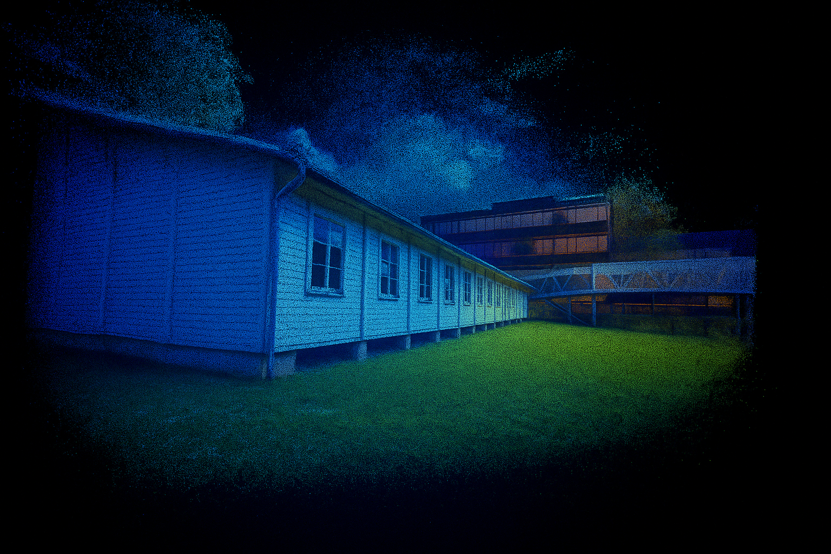
Datasets and Setup
ETH3D(3D Triangulation)
Indoor and Outdoor scenes
Accurate laser - scanned point clouds for geometry benching
IMC Phototourism
Camera Pose Estimation
Landmarks, overlapping views
CO3DV2
Type: Object videos Object shown in many angles.
Wide baselines, 51 Object categories from MS COCO

Slide 15
Training pipeline and loss function
Tracker training
Module | Loss Function | Purpose
Tracking loss | Point Location(𝑦ᵢʲ), Visibility(𝑣ᵢʲ), inverse invariance(σᵢʲ) | Penalize inaccurate 2D point Tracking with uncertainty-aware weighting
Camera Pose Loss | Rotation translation errors | Penalize camera pose deviation(b/w predicted & groundtruth)
Triangulation Loss | Reprojection error + epipolar constraint | Ensure 3D points when projected into images, match the 2D points.
Camera Initializer training
Triangulator
End to end joint Training

Slide 16
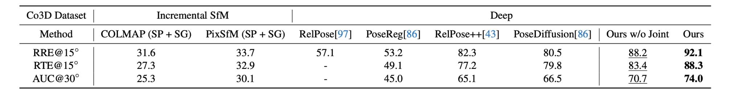
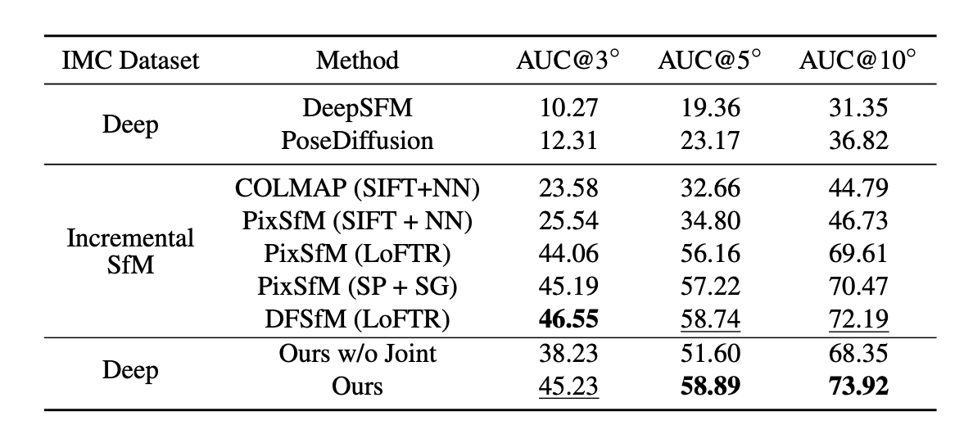
Camera Pose Estimation (CO3DV2 + IMC)
VGGSfM achieves state-of-the-art results on both Co3Dv2 and IMC datasets.
On Co3Dv2, it surpasses RelPose++ and PoseDiffusion by +9–10% in RRE, RTE, and AUC@30°.
On IMC, VGGSfM delivers the best AUC@10 (73.92%) and AUC@5, despite strong baselines.
Performs robustly in both wide-baseline (Co3Dv2) and dense-view (IMC) scenarios.
Fully differentiable pipeline enables end-to-end optimization for better generalization

Slide 17
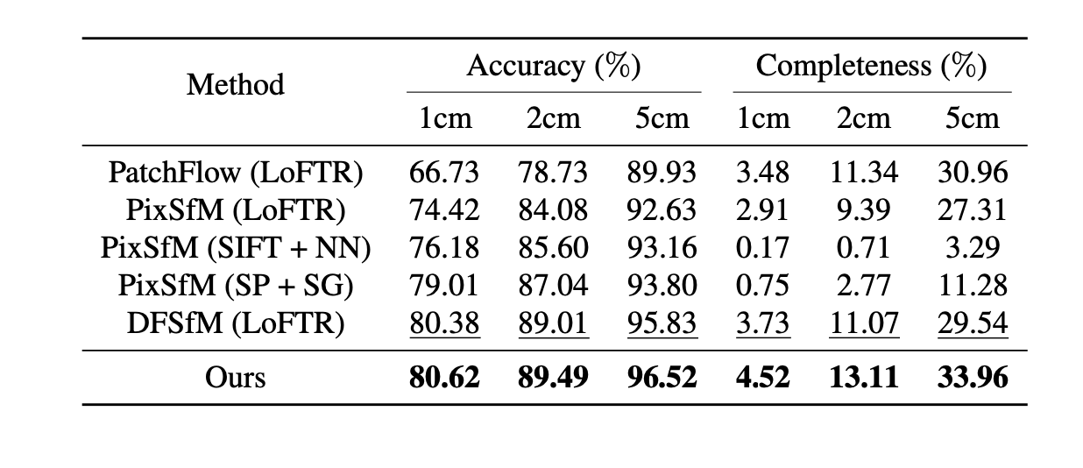
3D Triangulation (ETH3D)
VGGSfM achieves highest accuracy at all thresholds (1cm, 2cm, 5cm)
Outperforms DFSfM and PixSfM by a clear margin in completeness
Completeness @5cm: 33.96%, Accuracy @1cm: 80.62%
Consistent gains, regardless of keypoint/matching method used
Demonstrates superior 3D reconstruction quality

Slide 18
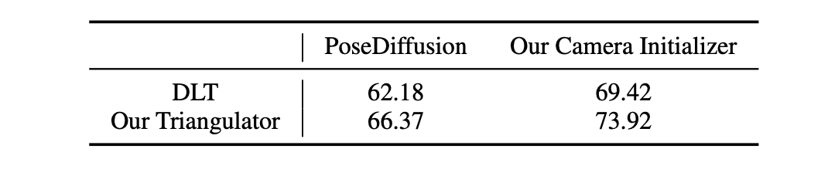
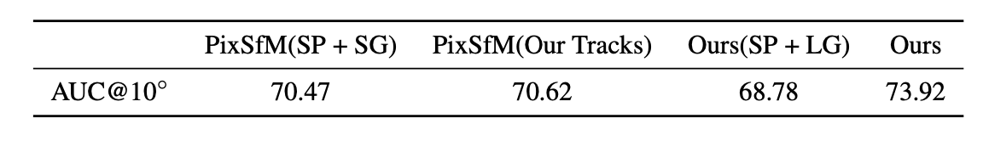
Ablation Study
End-to-end training improves AUC@10 by 5.5%
Our camera initializer outperforms PoseDiffusion
Our triangulator > DLT by a clear margin
Standard SP+SG tracks hurt performance in our pipeline
Coarse-to-fine tracking is critical for sub-pixel accuracy

Slide 19
Implementation
Training Pipeline Highlights
Pretrained on Kubric, fine-tuned on Co3D / MegaDepth
Trained in 3 phases: Tracker → Initializer + Triangulator → End-to-end
Trained using 32×A100 GPUs, joint phase took ~1 day
Optimizer: AdamW, LR = 0.0001 (joint), 0.0005 (pre-stages)
Augmentations: Color jitter, blur, grayscale (randomized per frame)
Architecture Insights
Camera Initializer: Cross-attention + Transformer; predicts rotation, translation, focal length
Triangulator: Uses DLT, point-ray distances, and Transformer to refine 3D points
Coarse-to-fine tracker uses sub-pixel refinement
Filtering: reprojection, epipolar & visibility checks applied

Slide 20
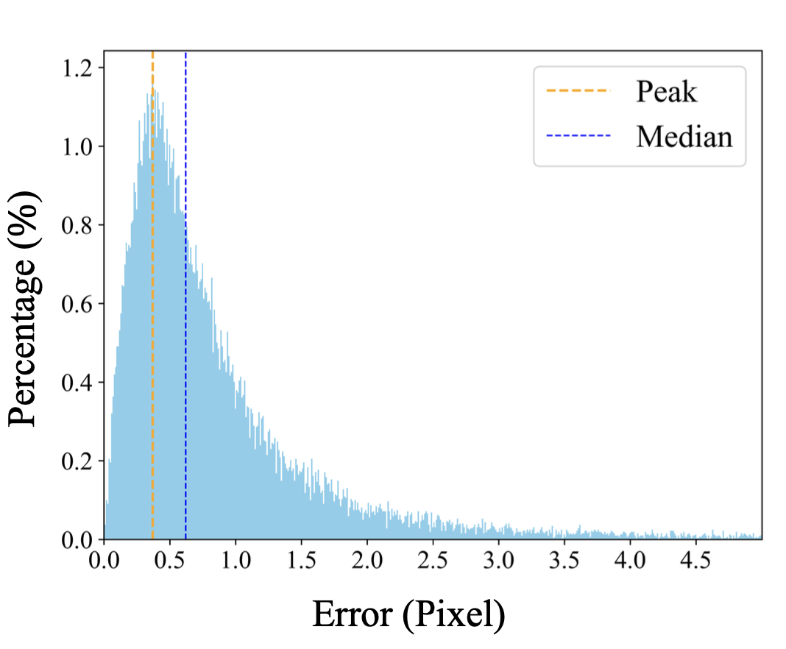
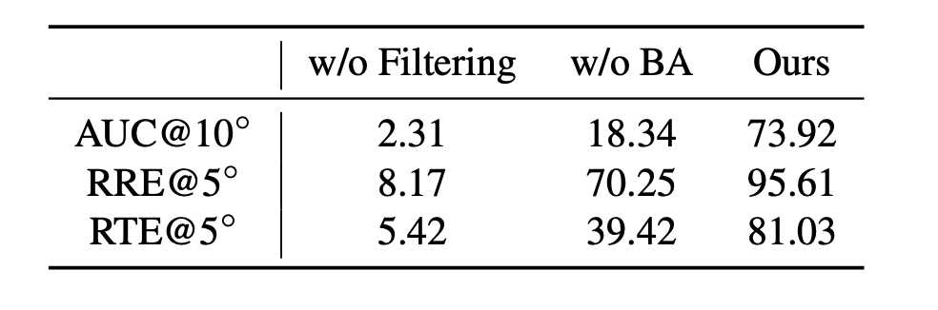
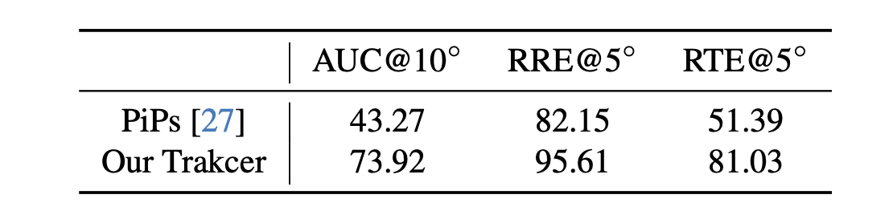
Discussions and Ablation
Bundle Adjustment (BA) is crucial: Removing it drops AUC@10 from 73.92% to 18.34%
Noisy tracks harm BA: Without filtering, performance drops drastically to AUC@10 = 2.31%
Our tracker outperforms PiPs: AUC@10 improved from 43.27% → 73.92%
Error distribution: Most predictions are within 0.4–0.6 pixels, indicating high tracking precision
Global SfM inspired: We predict tracks directly, avoid averaging, and optimize iteratively
Bundle Adjustment
Keypoint Errors
Ablation Study for Tracking

Slide 21
Conclusion
End-to-end differentiable SfM system
Outperforms classical methods on key benchmarks
Simple yet highly accurate pipeline
Fully Python-based and extensible
Future scope: scale to large scenes, integrate with SLAM

Slide 22
Thankyou

